Slide 1
Intro To Programming JavaScript

Slide 2
Brief Summary Of Chapter 7
What is a Prompt
Using The Confirm Function
What is an Alert
Using Pseudocode
Tracking the State
Designing Your Game
Chapter 7: Creating a Hangman Game

Slide 3
A prompt is a message or box that asks the user for input or action. It's used to guide users, collect information, confirm choices, and improve the overall experience.
EXAMPLE: (B-p134 & L-p107)
What is a Prompt?

Slide 4
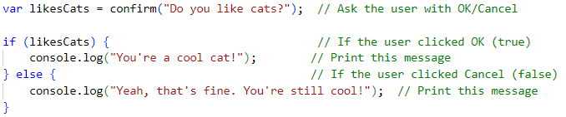
confirm() shows a message with "OK" and "Cancel" buttons. It returns true if the user clicks "OK" and false if they click "Cancel". It's used to confirm actions like deleting or submitting.
EXAMPLE: (B-p135 & L-p108)
Using The Confirm Function

Slide 5

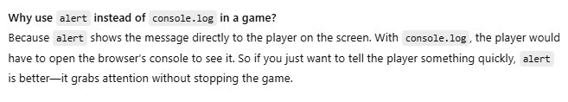
An alert is a message that pops up to tell users something important, like an error or update. It can be used to warn, inform, or get attention.
EXAMPLE: (B-p136 & L-p109)
What is an Alert?

Slide 6
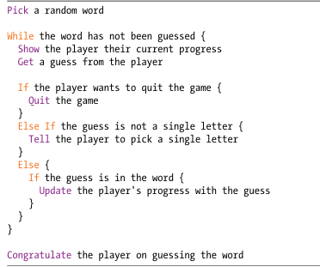
Pseudocode is used to outline the logic of an algorithm in a way that is not specific to any programming language. It helps developers plan and visualize the steps of a program without focusing on the details of coding syntax. This makes it easier to design and discuss solutions before translating them into actual code.
Using Pseudocode

Slide 7
Tracking the state in Hangman involves keeping an array of blanks that represents the letters in the secret word. As the player guesses letters, the array is updated to show correct guesses, replacing blanks with the guessed letters. This helps display the player’s progress in revealing the word.
EXAMPLE: (B-p139 & L-p112)
If the secret word is "fish" the initial array of blanks is ["_", "_", "_", "_"].
Tracking the State

Slide 8
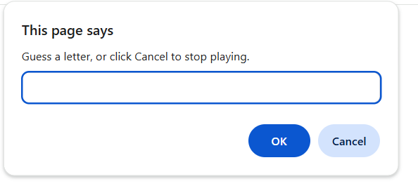
Create an array of words
Create the Answer Array
Code the game loop
Show the Player’s Progress
Handle the Player’s Input
Update the Game State
End the game by Show the answer and congratulate the player Game code(B-p145 - 147 & L-p118 - 120)
Designing Your Game

Slide 9

Do the Programming Challenges then upload to github.
Page (B-148 & L-121)
Practice Exercises

Slide 10

End Of Chapter 7

